Slide 1
Serial Adders
Lecture_13bc_Serial Adders_Moore_Design
Reference: Chapter 8, section 8.5, page 477, Stephen Brown, ZvonkoVranesic, “Fundamentals of Digital Logic with VerilogDesign”, Tata McGraw Hill Publishing Company Limited, Second Edition

Slide 2
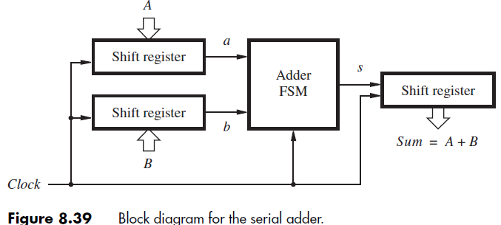
Serial Adders
Circuits which adds bits in a pair synchronously with clock

Slide 3
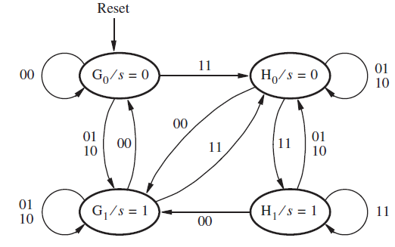
G0 = state where carry-in=0 and output sum=0
G1 = state where carry-in=0 and output sum=1
H0 = state where carry-in=1 and output sum=0
H1 = state where carry-in=1 and output sum=1

Slide 4
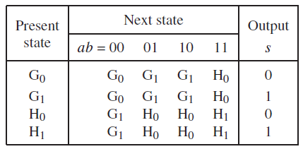

Slide 5
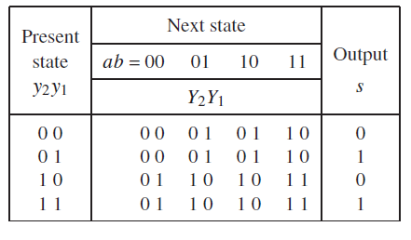

Slide 6
